Slide 1
CS 4974 Independent Study
9/1/22 meeting
Student: Bug Lee

Slide 2
Last time, we discussed…
Moving to C++ and using C++ Catch2 Testing Framework
Lexer/Tokenizer implementation
Regular expression and State machine

Slide 3
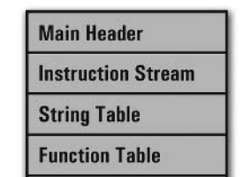
Week 1-2
compiler
assembler
script.source
script.assembly
script.executable
Virtual Machine
CPU

Slide 4
Assembly Lexer

Slide 5
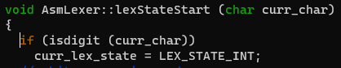
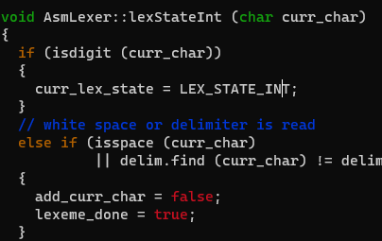
Regular expression and State machine
[0-9]
Start
[0-9]
Int
[ \t]
TOKEN_INT

Slide 6
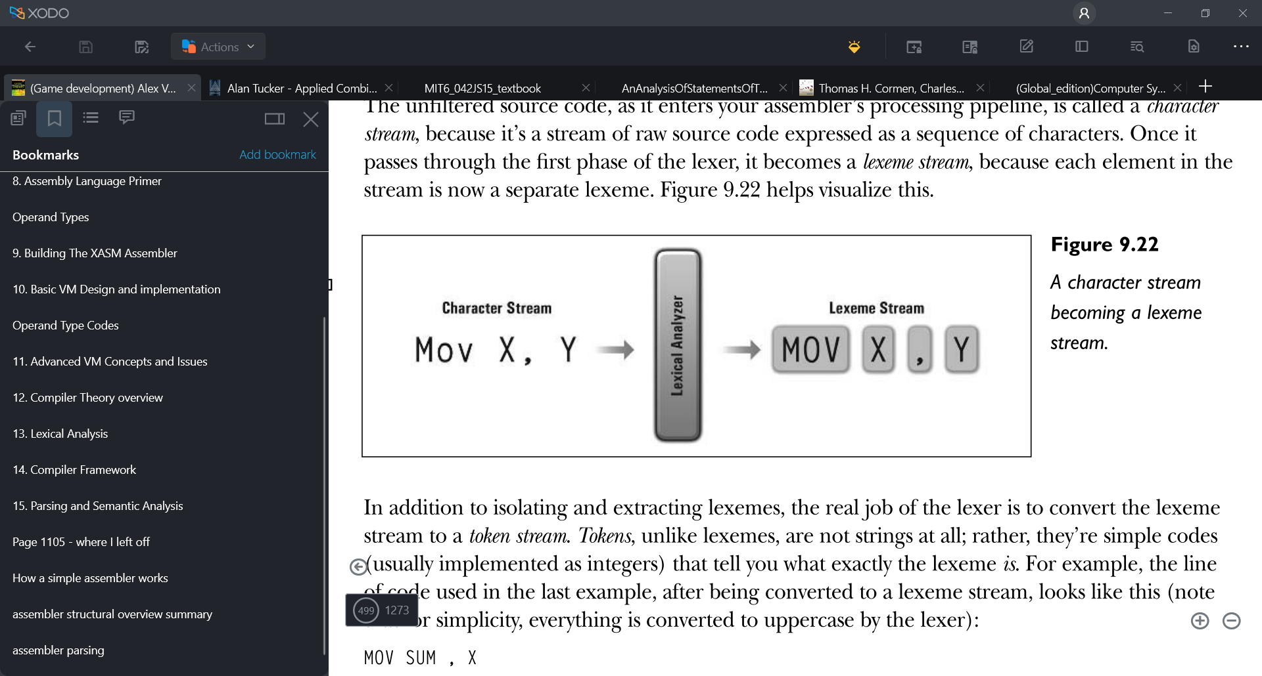
Lexer
getNextToken ()
-> TOKEN_TYPE_INSTR
getCurrLexeme ()
-> “mov”

Slide 7
Assembly Parser

Slide 8
Recursion decent w/o recursion
Parse Instruction
Check
1st Token
Parse Line
Parse directive
Parse Label

Slide 9
Parse instruction
Instruction lookup table
…
Mov Destination, Source
Add to in-memory
instruction stream
Check for match
…
0 4 1 4 2
[opcode] [type] [value] [type] [value]
(Identifier) (stack index) (Identifier) (stack index)

Slide 10
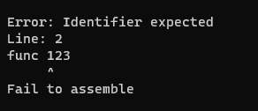
Error handling

Slide 11
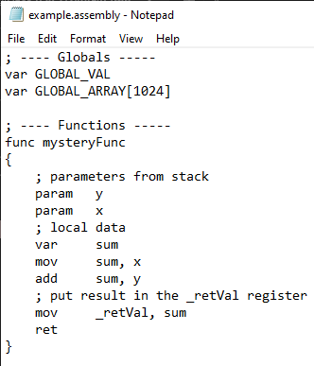
In-memory
Instruction stream
Symbol Table
Parser
Function Table
Label Table
String Table

Slide 12
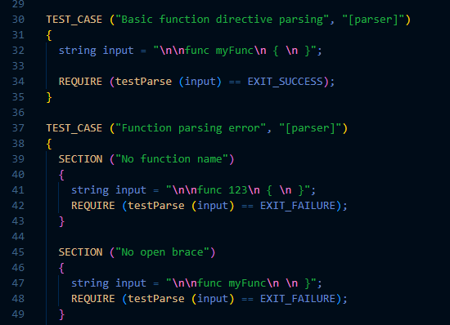
Catch2 Testing Framework

Slide 13
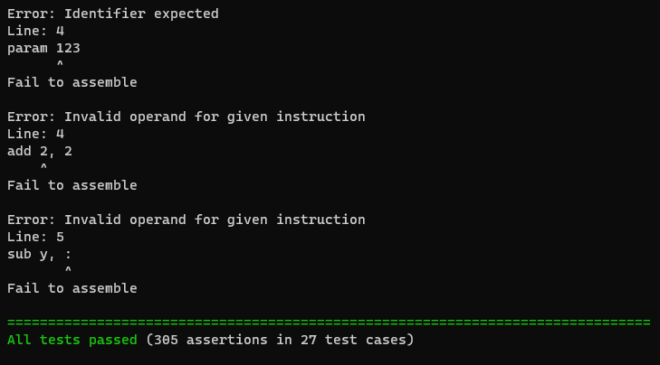

Slide 14
Plan for week 3
Finalize assembly parser
Write driver program for assembler to build executable
Start working on Framework for Virtual Machine

